Slide 1
FAITH PRESBYTERIAN CRC
WORSHIP SERVICE
October 23, 2022
Worship Leaders: Various plus Pastor Frank Guter

Slide 2
Prelude
Please use this time
To prepare for Worship

Slide 3
Welcome
& Opening Prayer

Slide 4
Responsive Call to Worship

Slide 5
RESPONSIVE CALL TO WORSHIP
L: Come, all who are thirsty says Jesus, our Lord,
P: come, all who are weak, taste the living water
that I shall give.
L: Dip your hands in the stream, refresh body and soul,
P: drink from it, depend on it, for this water
will never run dry.
ALL: Come, all who are thirsty says Jesus, our Lord.

Slide 6
First Song
[Red] # 296 We Are Called

Slide 7
Second Song
[Red] # 340 I Give You My Heart

Slide 8
God’s Greeting
& Mutual Greeting

Slide 9
We Receive Fresh Grace:
Celebrating Our Lord Jesus

Slide 10
THE APOSTLE’S CREED (1)
I believe in God, the Father almighty,
creator of heaven and earth.
I believe in Jesus Christ, his only Son, our Lord,
who was conceived by the Holy Spirit
and born of the virgin Mary.

Slide 11
THE APOSTLE’S CREED (2)
He suffered under Pontius Pilate,
was crucified, died, and was buried;
he descended to hell.
The third day he rose again from the dead.
He ascended to heaven
and is seated at the right hand of God
the Father almighty.

Slide 12
THE APOSTLE’S CREED (3)
From there he will come to judge
the living and the dead.
I believe in the Holy Spirit,
the holy catholic church,
the communion of saints,
the forgiveness of sins,
the resurrection of the body,
and the life everlasting. Amen.

Slide 13
RESPONSIVE CALL TO WORSHIP (1)
L: There is one hope, one calling, to which
we are called.
P: The hope in our lives is Jesus.
L: There is one hope, one calling, to which
we are called.
P: The call we must answer is God’s.
L: There is one faith, one hope, one Lord of us all.
P: The Lord of our lives is Jesus.

Slide 14
RESPONSIVE CALL TO WORSHIP (2)
L: There is one baptism, one Father, of all.
P: The creator who calls us is God.
L: We are one body, one family, one church,
P: woven by the Spirit with bonds of peace.
L: With Christ’s children throughout all of this earth,
P: we are one body in unity and love.

Slide 15
Service of Baptism
for Liliane Elena Carrera

Slide 16
BAPTISM QUESTONS (1)
Do you believe that JC is the Son of God sent
to redeem the world, do you love and trust him
as the one who saves you from your sin,
and do you with repentence and joy embrace him
as Lord of your life?
[Yes, I do]

Slide 17
BAPTISM QUESTONS (2)
Do you believe that the Bible is the Word of God, revealing Christ and his redemption, and that
the confessions of this church faithfully reflect
this revelation?
[Yes, I do]

Slide 18
BAPTISM QUESTONS (3)
Do you promise to do all you can, with the help of
the Holy Spirit, to strengthen your love and commitment to Christ by sharing faithfully in the life
of the church, honoring and submitting to its authority; and do you join with the people of God in doing
the work of the Lord everywhere?
[Yes, I do]

Slide 19
PROMISES by the Congregation
Do you promise to love, encourage, and support OUR SISTER LILY by sharing with her the gospel of God’s love, by being an example of Christian faith and character,
And by giving the strong support of God’s family in fellowship, teaching, prayer, and service?
REPLY: Yes, we do, God helping us.

Slide 20
HYMN
[CH] # 571 vv.1, 4, 5
Trust and Obey

Slide 21
PRAYERS OF THE PEOPLE

Slide 22
General Offering: Ministry Fund
Special Offering
CRCNA Ministry Shares

Slide 24
Message:
“We humbly follow our crucified Jesus along our journey of faith,
as he helps us to see things clearly
and speak about our faith ”

Slide 25
Introductory Comments

Slide 26
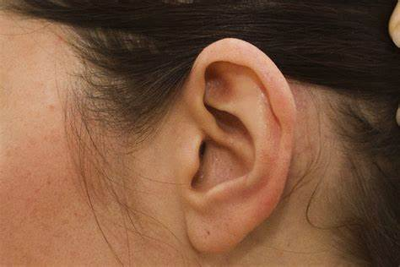
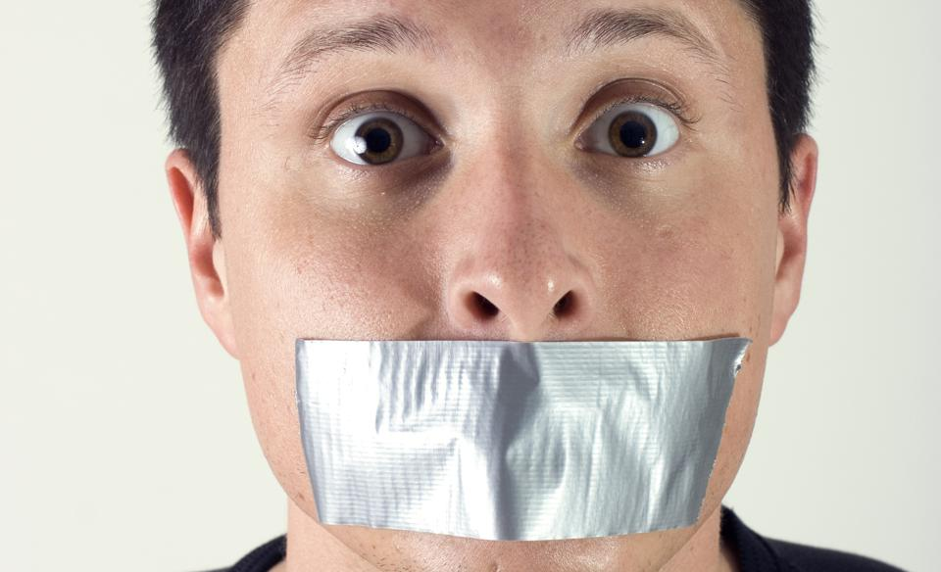

Slide 34
PRAYER OF ILLUMINATION

Slide 35
Scripture Reading: Mark 10:32--52 pg. 1
³² They were on their way up to Jerusalem,
with Jesus leading the way, and the disciples
were astonished, while those who followed
were afraid. Again he took the Twelve aside
and told them what was going to happen to him.

Slide 36
Scripture Reading: Mark 10:32--52 pg. 2
³³ “We are going up to Jerusalem,” he said, “and the Son of Man will be delivered over to the chief priests and the teachers of the law. They will condemn him to death and will hand him over to the Gentiles, ³⁴ who will mock him and spit on him,
flog him and kill him. Three days later he will rise.”

Slide 37
Scripture Reading: Mark 10:32--52 pg. 3
³⁵ Then James and John, the sons of Zebedee, came to him. “Teacher,” they said, “we want you to do for us whatever we ask.”
³⁶ “What do you want me to do for you?” he asked.
³⁷ They replied, “Let one of us sit at your right
and the other at your left in your glory.”
³⁸ “You don’t know what you are asking,”
Jesus said. “Can you drink the cup I drink or
be baptized with the baptism I am baptized with?”

Slide 38
Scripture Reading: Mark 10:32--52 pg. 4
³⁹ “We can,” they answered.
Jesus said to them, “You will drink the cup I drink
and be baptized with the baptism I am baptized with, ⁴⁰ but to sit at my right or left is not for me
to grant. These places belong to those for whom
they have been prepared.”
⁴¹ When the ten heard about this, they became indignant with James and John. ⁴² Jesus called them together
and said, “You know that those who are regarded
as rulers of the Gentiles lord it over them, and their high
officials exercise authority over them.

Slide 39
Scripture Reading: Mark 10:32--52 pg. 5
⁴³ Not so with you. Instead, whoever wants
to become great among you must be your servant, ⁴⁴ and whoever wants to be first must
be slave of all. ⁴⁵ For even the Son of Man did
not come to be served, but to serve, and to give
his life as a ransom for many.” ⁴⁶ Then they came
to Jericho. As Jesus and his disciples, together
with a large crowd, were leaving the city, a blind man, Bartimaeus (which means “son of Timaeus”), was sitting by the roadside begging.

Slide 40
Scripture Reading: Mark 10:32--52 pg. 6
⁴⁷ When he heard that it was Jesus of Nazareth,
he began to shout,
“Jesus, Son of David, have mercy on me!”
⁴⁸ Many rebuked him and told him to be quiet,
but he shouted all the more,
“Son of David, have mercy on me!”
⁴⁹ Jesus stopped and said, “Call him.”
So they called to the blind man,
“Cheer up! On your feet! He’s calling you.”

Slide 41
Scripture Reading: Mark 10:32--52 pg. 7
⁵⁰ Throwing his cloak aside, he jumped to his feet and came to Jesus.
⁵¹ “What do you want me to do for you?”
Jesus asked him.
The blind man said, “Rabbi, I want to see.”
⁵² “Go,” said Jesus, “your faith has healed you.”
Immediately he received his sight
and followed Jesus along the road.

Slide 57
PRAYER OF RESPONSE

Slide 59
Hymn of Response
[CH] # 634
More Love to Thee

Slide 60
Closing Blessing

Slide 61
Closing Hymn
[Red] # 945
Send Me, Lord

