Slide 1
FAITH PRESBYTERIAN CRC
WORSHIP SERVICE
September 4, 2022
Worship Leaders: Various plus Pastor Frank Guter

Slide 2
Prelude
Please use this time
To prepare for Worship

Slide 3
First Song
[CH] # 128 I Sing the Mighty Power of God

Slide 4
Responsive Call to Worship

Slide 5
RESPONSIVE CALL TO WORSHIP (1)
L: Come, bless the Lord, in whom we find
our refuge and safety.
P: You are our God; all the good things
come from You alone.
L: Come, bless the Lord, who gives us a rich
inheritance, and surrounds us with abundance.
P: You are our God; our lives are in your hands.

Slide 6
RESPONSIVE CALL TO WORSHIP (2)
L: Come, bless the Lord, who guides us on the path
to eternal life, whose presence strengthens
and sustains us.
P: You are our God; we will not be shaken.
Let’s worship God together!

Slide 7
Second Song
[CH] # 429 vv. 1-3
They’ll Know We Are Christians

Slide 8
God’s Greeting
& Welcome

Slide 9
Opening Prayer

Slide 10
Unison Prayer of Confession
& Words of Assurance

Slide 11
UNISON PRAYER OF CONFESSION [1]
We are workers, God, just like you. But we confess that our actions do not always affirm and honor each other. Our work is not always done in a spirit that is pleasing to you. We confess that, on some occasions, we have blindly bought goods made by people who are paid too little or work in unsafe conditions.

Slide 12
UNISON PRAYER OF CONFESSION [2]
We admit that we have failed to end an unjust system in which some workers have jobs that provide good wages and benefits while others may have no job, or one that pays little and provides few benefits. Creator God, help us to be your people, working for a world where all workers are valued. A world where those who clean houses are also able to buy houses
to live in.

Slide 13
UNISON PRAYER OF CONFESSION [3]
A world where those who grow food can also afford to eat their fill. And one where those who serve and care for others – in stores, schools, hotels, restaurants, nursing homes, and many other places – are, themselves, also served and cared for. A world where all workers everywhere share in the abundance that you have given us. Please show us your mercy in Jesus name, Amen.

Slide 14
Celebrating our Faith
Responsively

Slide 15
RESPONSIVE CELEBRATION OF OUR FAITH (1)
L: We are glad today to salute all who labor to provide for their families and make our world
a better place.
P: Work is a noble enterprise. And every kind
of work is worthy of honor.

Slide 16
RESPONSIVE CELEBRATION OF OUR FAITH (2)
L: Through our work we teach others, care for
the affairs of our community, and cultivate
our world and our land.
P: Through our work, we seek to do our best and we seek to make this world a better place, each of us fulfilling our role in God’s grand design.

Slide 17
RESPONSIVE CELEBRATION OF OUR FAITH (3)
L: All who work ought to be compensated honorably, and their contributions to our society honored and not overlooked.
P: We bless the Lord, who gives us strength to work, grace to achieve, compassion to serve, and favor to excel.

Slide 18
Hymn
[CH] # 426 Blest Be the Tie That Binds

Slide 19
PRAYERS OF THE PEOPLE

Slide 20
General Offering: Ministry Fund
Special Offering
Resonate Ministry in Philippines

Slide 22
Message:
“Helping and Empowering Each Other in all Humility ”

Slide 23
Introductory Comments

Slide 24
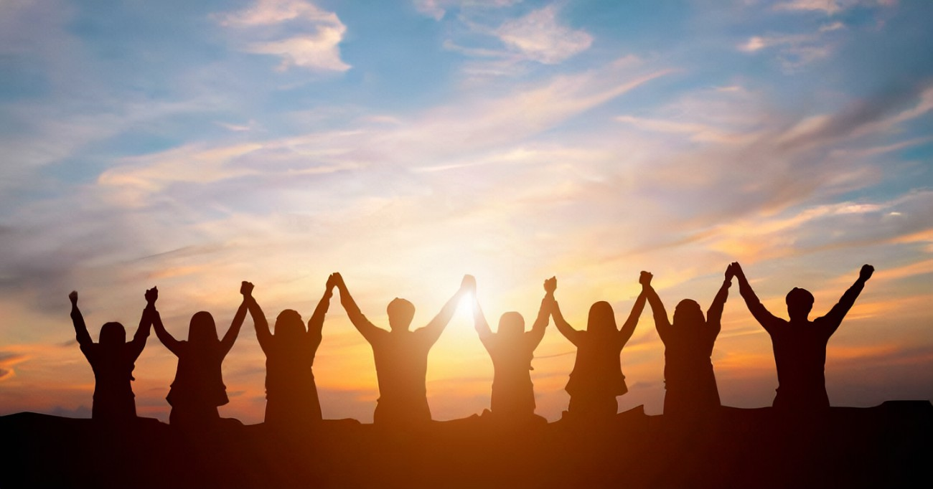

Slide 25
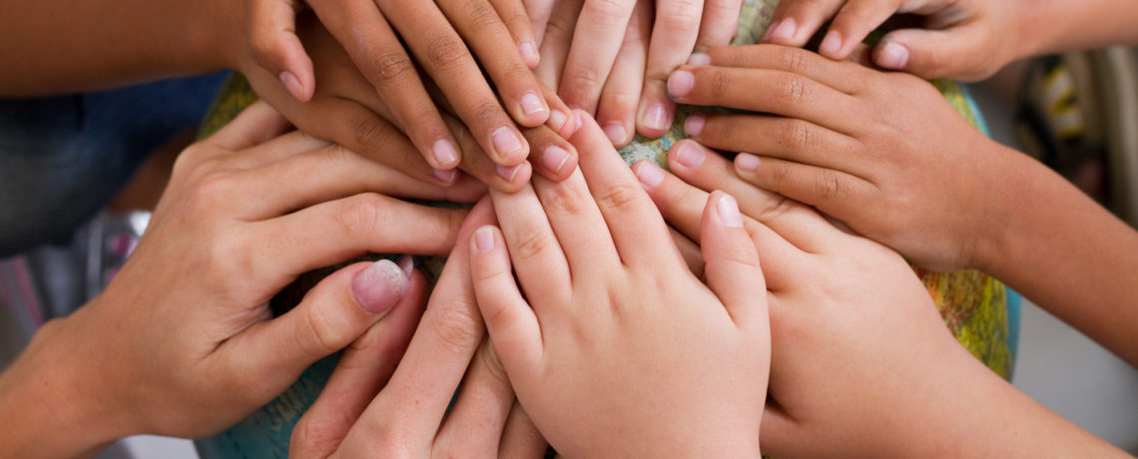

Slide 26
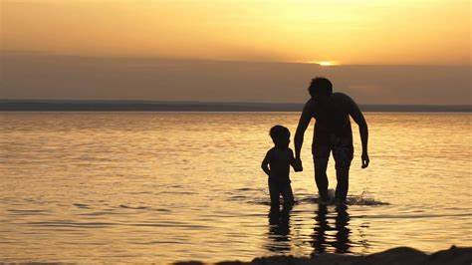

Slide 27
Pastor Frank Summary: (1)
Paul is finally applying lessons to help these Christians live in loving community.
[² Carry each other’s burdens, and in this way you will fulfill the law of Christ.]

Slide 28
Pastor Frank Summary: (2)
In this you care about sin, and you care that people need to be restored out of sin. But now this way is not harsh, but gentle, loving, righteous, patient, helpful.
[…you who live by the Spirit should restore that person gently.. But watch yourselves, or you also may be tempted. ² Carry each other’s burdens…]

Slide 29
Pastor Frank Summary: (3)
And then a big lesson is that this freedom you have found in Christ comes with obligations, that you practice good self-care and you keep from judging others and being conceited. And he offers a crucial encouragement, do not become weary of doing good.

Slide 30
Pastor Frank Summary: (4)
[³ If anyone thinks they are something when they are not, they deceive themselves. ⁴ Each one should test their own actions. Then they can take pride in themselves alone, without comparing themselves to someone else…(v. 9) let us not become weary of doing good…for we will reap a harvest; just don’t give up]

Slide 31
PRAYER OF ILLUMINATION

Slide 32
Scripture Reading: Galatians 6:1-10 pg. 1
Brothers and sisters, if someone is caught in a sin, you who live by the Spirit should restore that person gently. But watch yourselves, or you also may be tempted. ² Carry each other’s burdens, and in this way you will fulfill the law of Christ. ³ If anyone thinks they are something when they are not, they deceive themselves.

Slide 33
Scripture Reading: Galatians 6:1-10 pg. 2
⁴ Each one should test their own actions. Then they can take pride in themselves alone, without comparing themselves to someone else, ⁵ for each one should carry their own load. ⁶ Nevertheless, the one who receives instruction in the word should share all good things with their instructor.
.

Slide 34
Scripture Reading: Galatians 6:1-10 pg. 3
⁷ Do not be deceived: God cannot be mocked. A man reaps what he sows. ⁸ Whoever sows to please their flesh, from the flesh will reap destruction; whoever sows to please the Spirit, from the Spirit will reap eternal life. ⁹ Let us not become weary in doing good, for at the proper time we will reap a harvest if we do not give up. ¹⁰ Therefore, as we have opportunity, let us do good to all people, especially to those who belong to the family of believers.
.

Slide 35
Scripture Reading: Galatians 6:14-15 pg. 4
¹⁴ May I never boast except in the cross of our Lord Jesus Christ, through which the world has been crucified to me, and I to the world. ¹⁵ Neither circumcision nor uncircumcision means anything; what counts is the new creation.

Slide 36
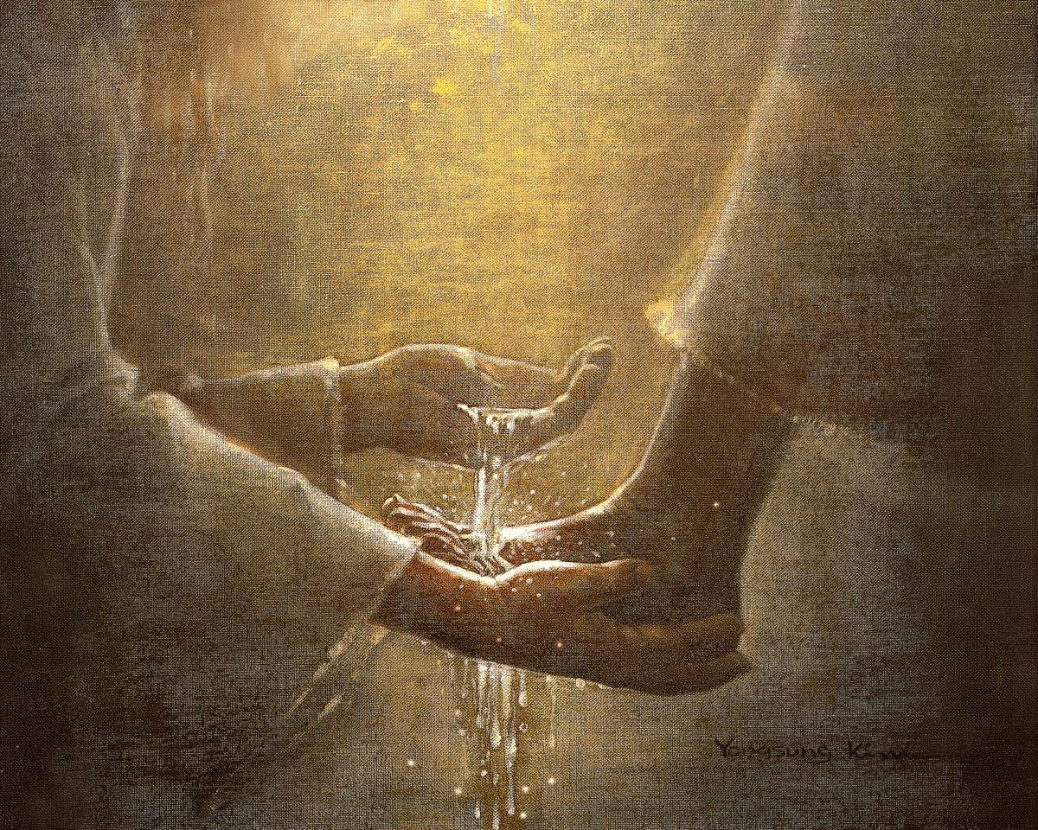
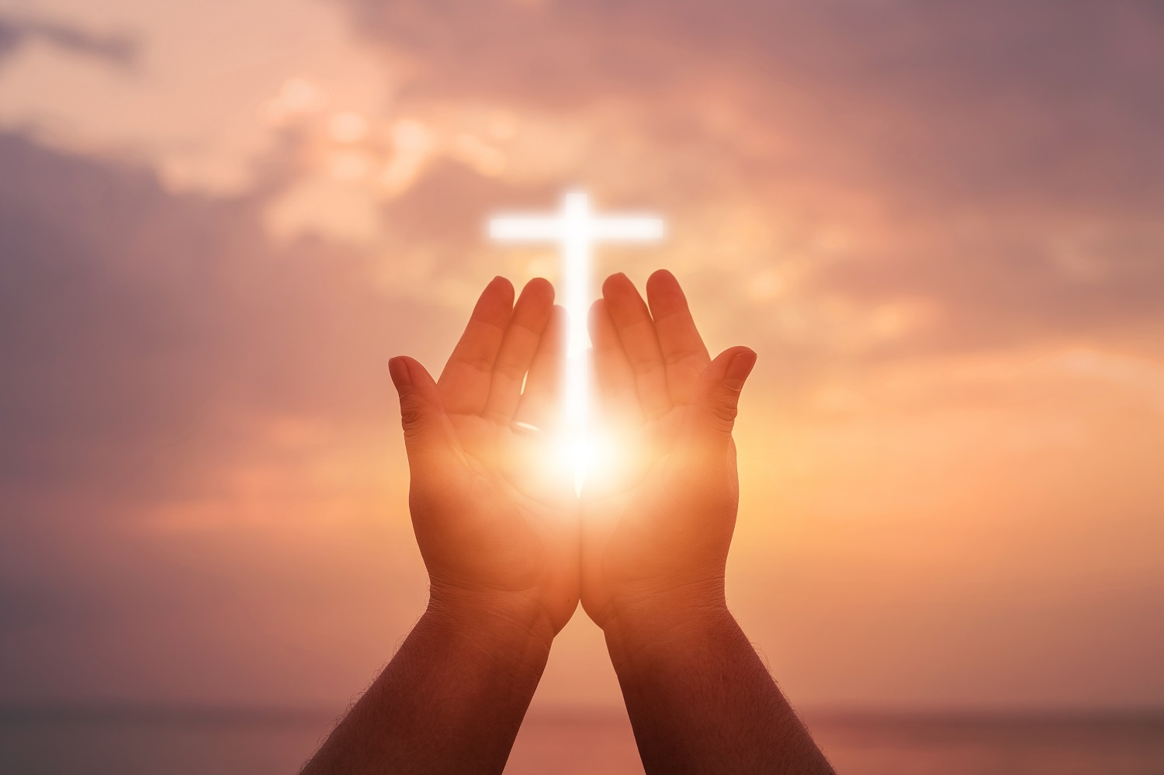

Slide 38
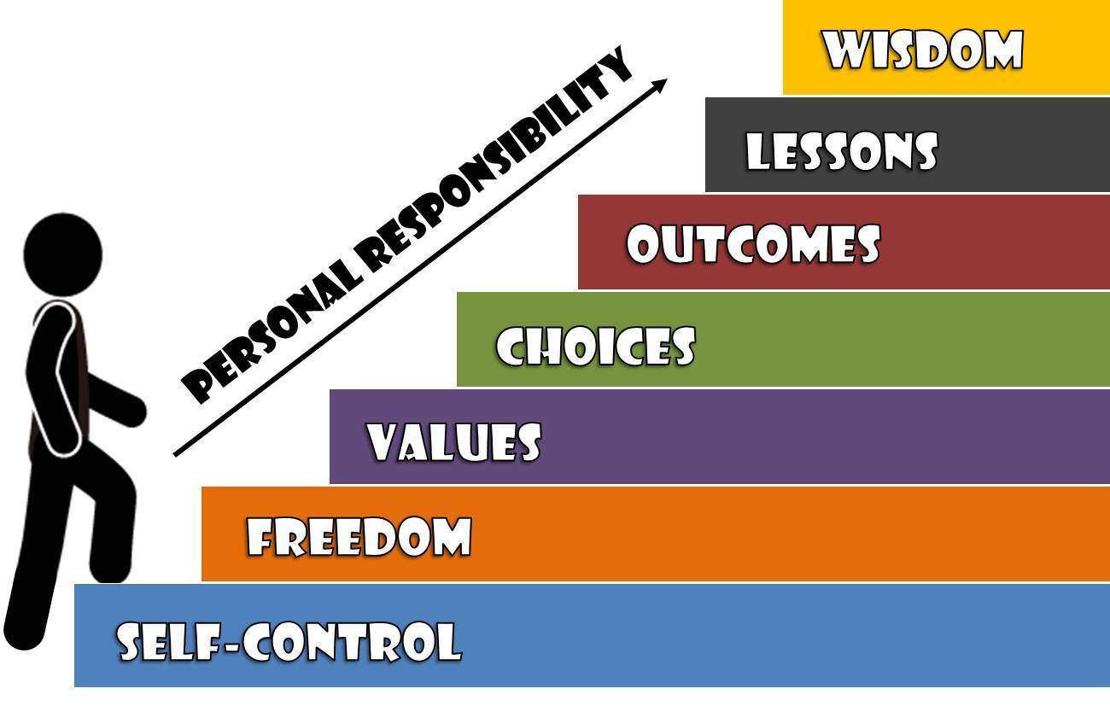

Slide 40
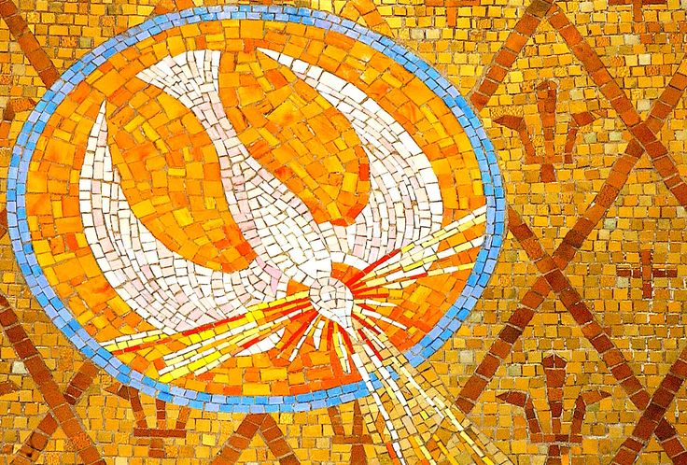

Slide 41
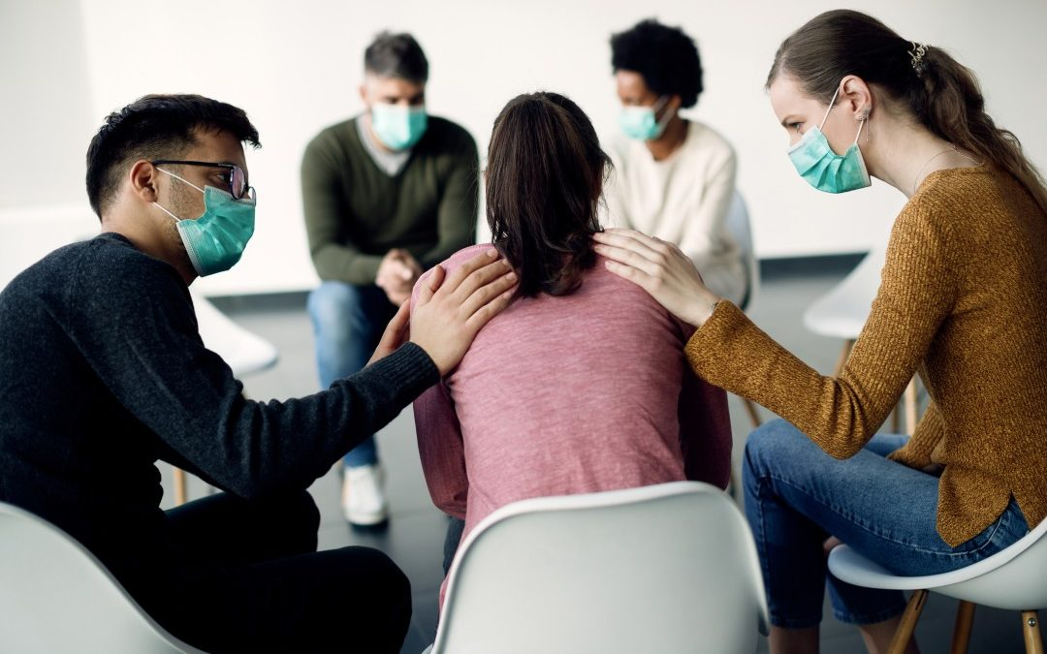

Slide 42
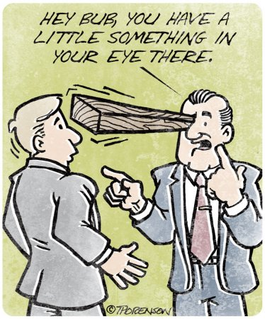

Slide 44
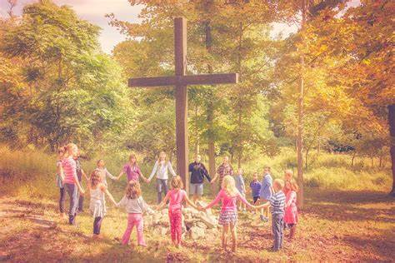

Slide 45
Scripture Reading: Galatians 6
¹⁴ May I never boast except in the cross of our Lord Jesus Christ, through which the world has been crucified to me, and I to the world. ¹⁵ Neither circumcision nor uncircumcision means anything;
what counts is the new creation.

Slide 46
Message:
“Helping and Empowering Each Other in all Humility ”

Slide 48
PRAYER OF RESPONSE

Slide 49
Hymn of Response
[Red] # 904 vv. 1,3,4
Lord, Make Us Servants

Slide 50
Closing Blessing

Slide 51
Sung Blessing

Slide 52
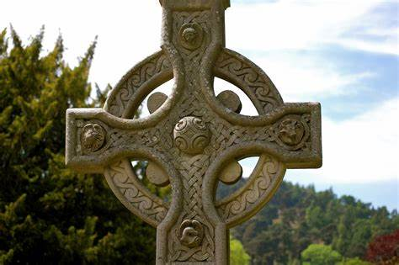
The Irish Blessing
May the road rise up to meet you,
May the wind be always at your back,
May the sun shine warm upon your face,
And the rains fall soft upon your fields.

Slide 53
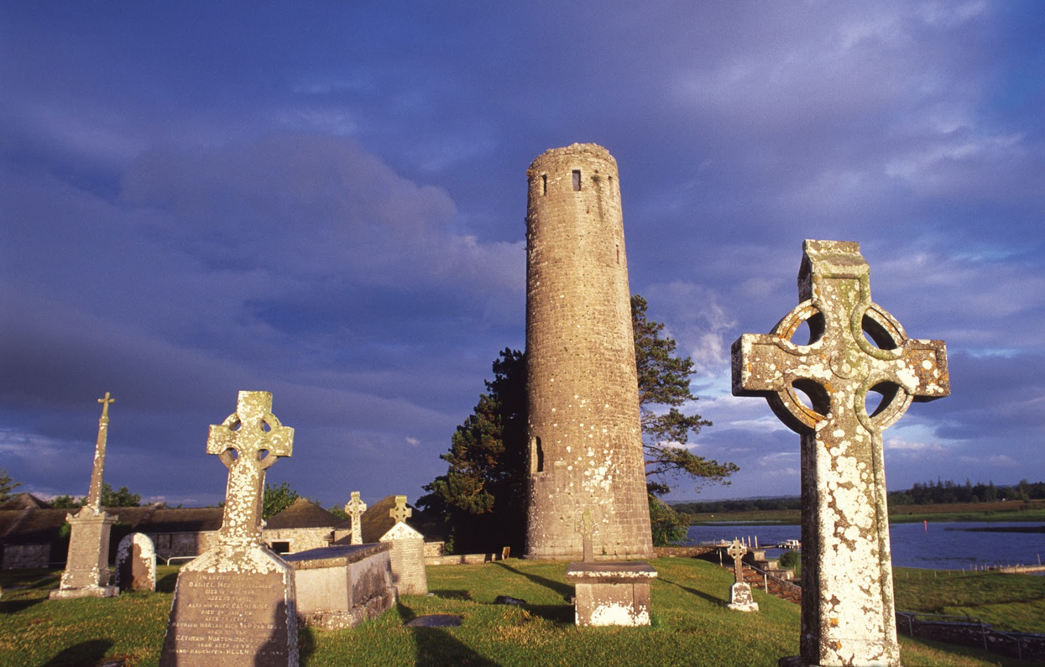
Until we meet again my friends, until we meet again,
May God hold you in the palm of His hand.

Slide 54
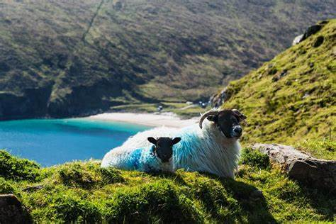
May the road rise up to meet you,
May the wind be always at your back,
May the sun shine warm upon your face,
And the rains fall soft upon your fields
'til we meet again, we meet again.
May God hold you in His hand.

