Slide 1
FAITH PRESBYTERIAN CRC
WORSHIP SERVICE
August 28, 2022
Worship Leaders: Various plus Pastor Frank Guter

Slide 2
Opening Song
[CH] # 3 Holy, Holy, Holy

Slide 3
Responsive Call to Worship

Slide 4
RESPONSIVE CALL TO WORSHIP (1)
L: Come into this sacred space to worship God P: whose teaching is perfect;
whose directions are sure. L: Come into this holy place to worship God P: whose standards are right;
whose commandment is clear;
whose judgements are true.

Slide 5
RESPONSIVE CALL TO WORSHIP (2)
L: Come with holy fear – to be given life,
and made wise, to have your heart stirred
and your eyes opened wide.
Come — let us worship God. P: Let the words of our mouths and the content of
our hearts be according to your will, O God. Amen.

Slide 6
Second Song
[Gray] # 239 vv. 1 & 3
Amid the Thronging Worshippers

Slide 7
God’s Greeting
& Welcome

Slide 8
Opening Prayer

Slide 9
Confirming Our Need

Slide 10
Celebrating Our Faith
Responsively

Slide 11
RESPONSIVE CELEBRATION OF OUR FAITH (1)
Heidelberg Cathechism Q & A 18
L--18 Q. Then who is this mediator—true God
and at the same time a true and righteous human?
P--A. Our Lord Jesus Christ,who was given to us to completely deliver us and make us right with God.

Slide 12
RESPONSIVE CELEBRATION OF OUR FAITH (2)
Heidelberg Cathechism Q & A 19 L: How do you come to know this?
A. The holy gospel tells me. God began to reveal the gospel already in Paradise; later God proclaimed it
by the holy patriarchs and prophets and foreshadowed it by the sacrifices and other ceremonies of the law; and finally God fulfilled it through his own beloved Son.

Slide 13
Hymn
# 575 Leaning on the Everlasting Arms

Slide 14
PRAYERS OF THE PEOPLE

Slide 15
General Offering:
Ministry Fund
Special Offering
Pacific Islands Institute (PIU)

Slide 17
Message:
“In Christ, we live our Christian freedom by the power of the Holy Spirit ”

Slide 18
Introductory Comments

Slide 22
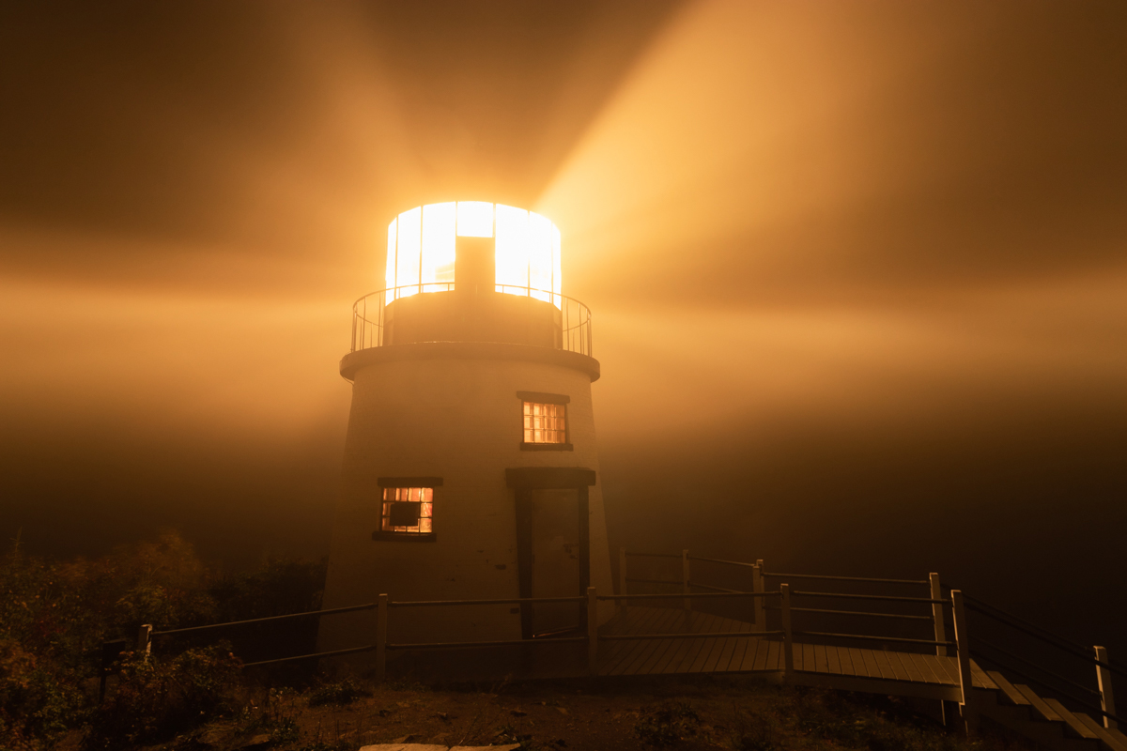

Slide 23
Pastor Frank Summary: (1)
Paul is reminding the Galatians to stay true to their original calling and not be diverted from it.
[ ⁷ You were running a good race. Who cut in on you
to keep you from obeying the truth?
⁸ That kind of persuasion does not come from
the one who calls you.]

Slide 24
Pastor Frank Summary: (2)
He is reminding them that their freedom in Christ results in a beautiful life of service and love.
[ ²² But the fruit of the Spirit is love, joy, peace,
forbearance, kindness, goodness, faithfulness,
²³ gentleness and self-control.
Against such things there is no law.]

Slide 25
Pastor Frank Summary: (3)
Once filled with these things, your freedom found in Christ will result in a life full of the Holy Spirit, where there is no longer any room for the terribly destructive behaviors that the law was designed to prevent.
[ ¹⁸ But if you are led by the Spirit, you are not under the law. ¹⁹ The acts of the flesh are obvious…]

Slide 26
PRAYER OF ILLUMINATION

Slide 27
Scripture Reading: Galatians 5:1 pg. 1
It is for freedom that Christ has set us free.
Stand firm, then, and do not let yourselves
be burdened again by a yoke of slavery.

Slide 28
Scripture Reading: Galatians 5:22-26 pg. 2
But the fruit of the Spirit is love, joy, peace,
forbearance, kindness, goodness, faithfulness,
²³ gentleness and self-control. Against such things there is no law. ²⁴ Those who belong to Christ Jesus have crucified the flesh with its passions and desires.

Slide 29
Scripture Reading: Galatians 5:22-26 pg. 3
²⁵ Since we live by the Spirit, let us keep in step
with the Spirit.
²⁶ Let us not become conceited, provoking
and envying each other.

Slide 30
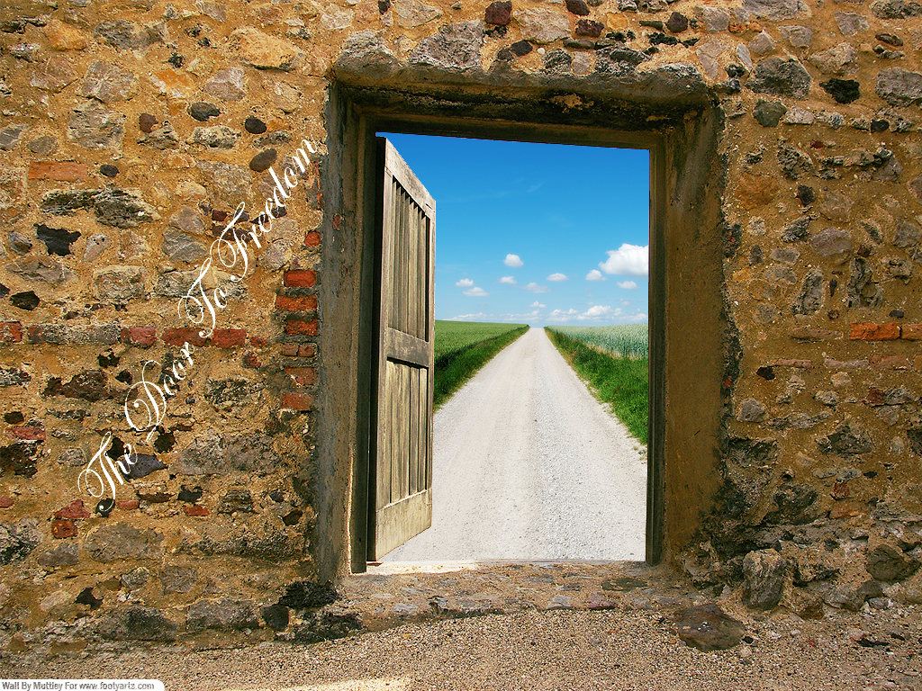

Slide 32
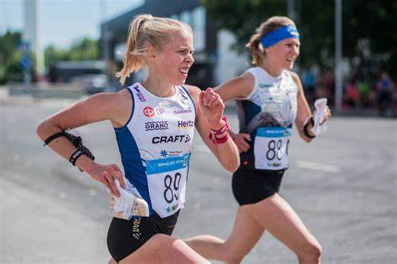

Slide 33
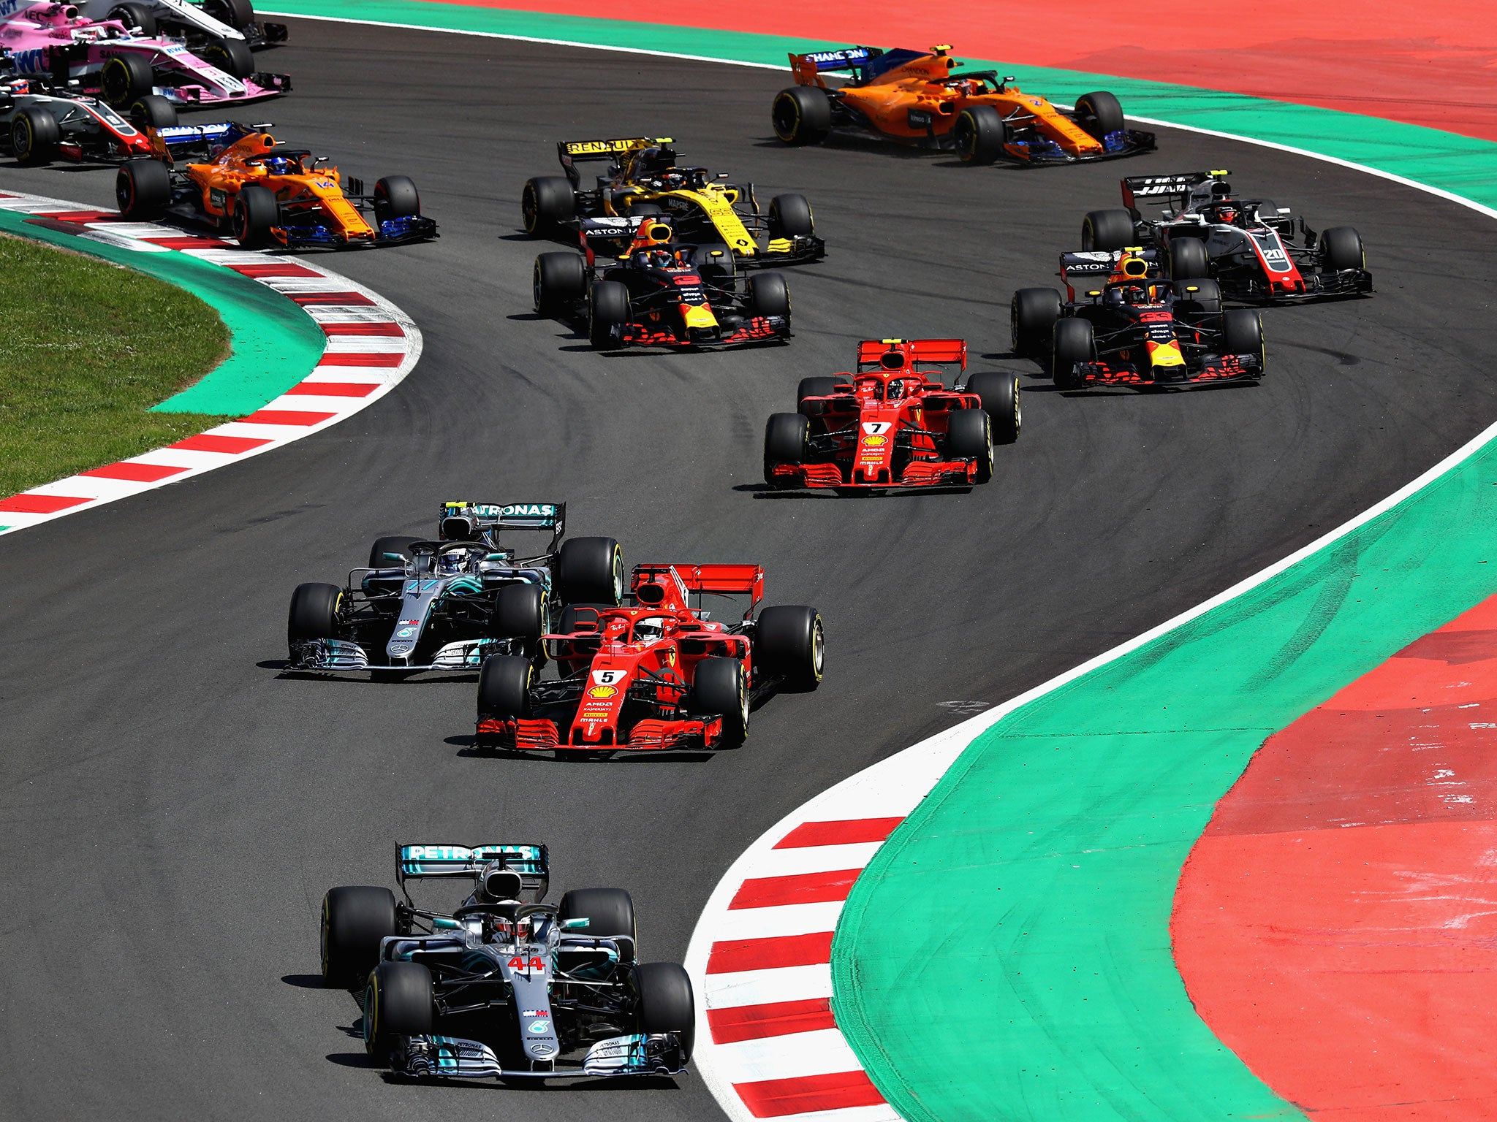

Slide 34
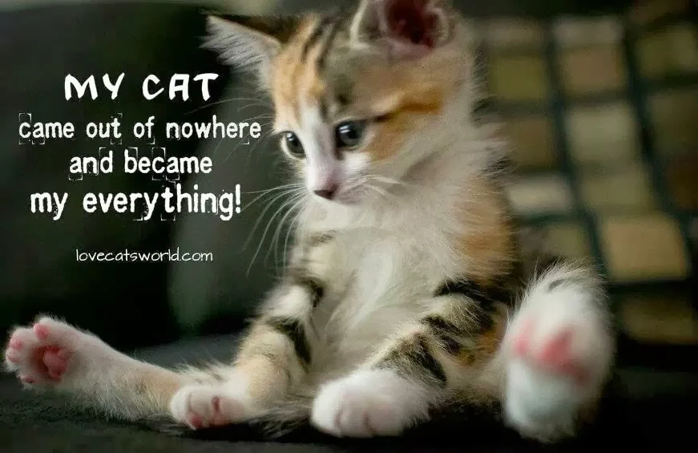

Slide 35
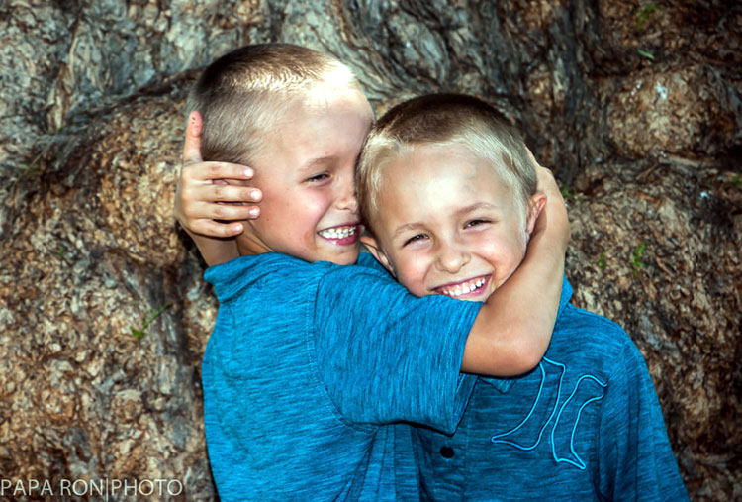

Slide 36
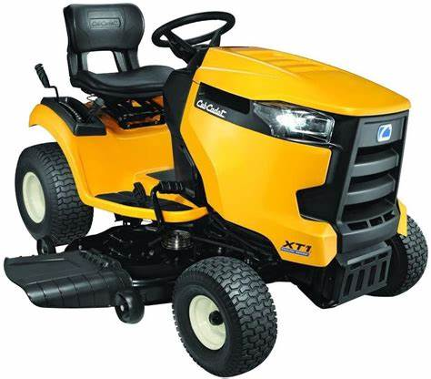
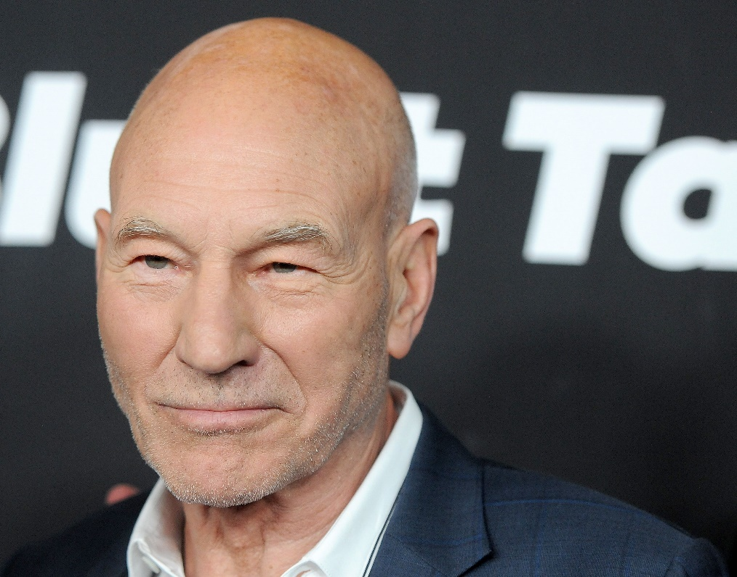
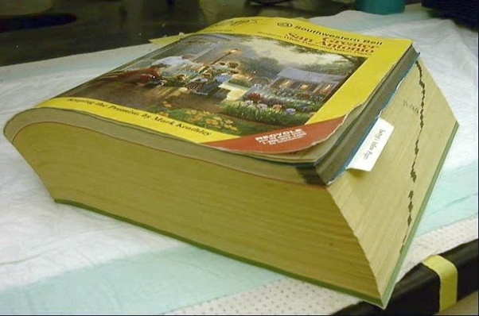

Slide 37
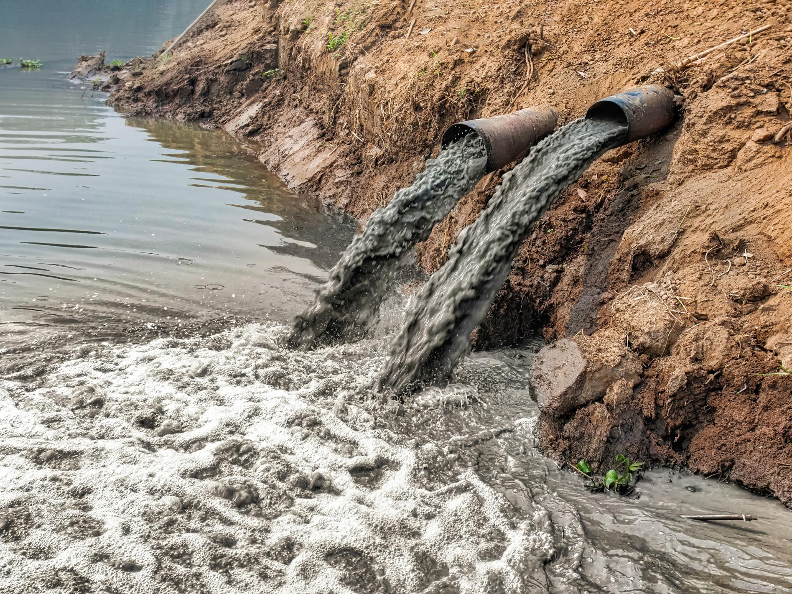

Slide 38
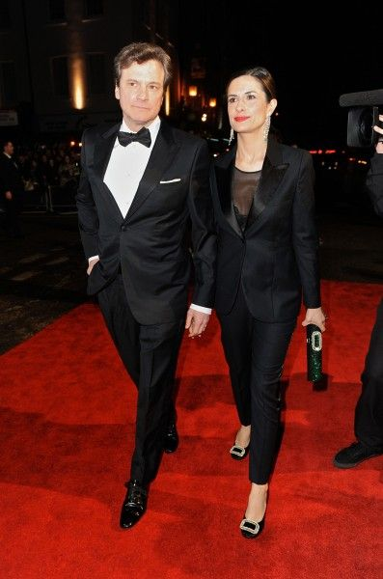

Slide 39
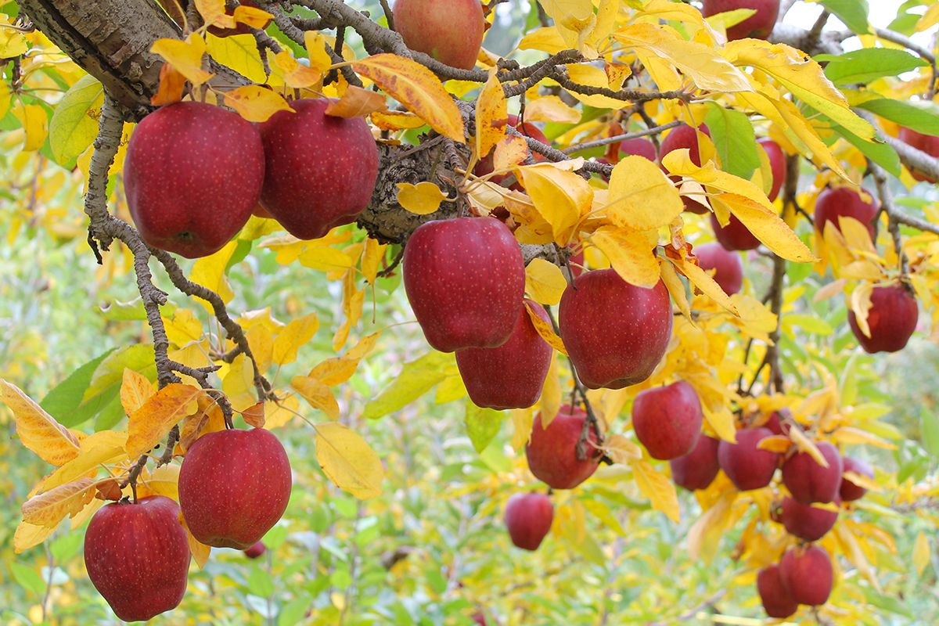
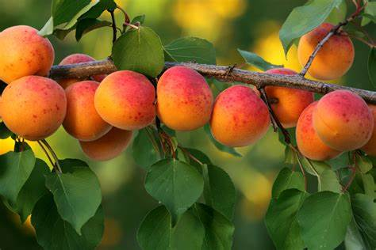
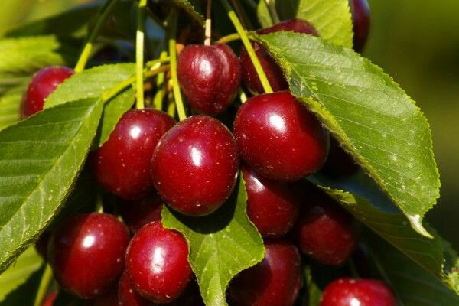

Slide 40
Scripture Reading: Galatians 5:22-23
²² But the fruit of the Spirit is love, joy, peace,
forbearance, kindness, goodness, faithfulness,
²³ gentleness and self-control.
Against such things there is no law.

Slide 42
Message:
“In Christ, we live our Christian freedom by the power of the Holy Spirit ”

Slide 44
PRAYER OF RESPONSE
with the Lord’s Prayer

Slide 45
THE LORD’S PRAYER (slide 1)
Our Father, who art in heaven,
hallowed be thy name;
thy kingdom come;
thy will be done; on earth as it is in heaven.

Slide 46
(slide 2)
Give us this day our daily bread.
And forgive us our debts,
as we forgive our debtors.

Slide 47
(slide 3)
Lead us not into temptation;
but deliver us from evil.
For thine is the kingdom,
the power and the glory, for ever.
Amen.

Slide 48
Hymn of Response
[Red] # 679 vv. 1&2
For Freedom Christ Has Set Us Free

Slide 49
Closing Blessing

Slide 50
Hymn of Response
[Red] # 679 vv. 1&2
For Freedom Christ Has Set Us Free

