Slide 1
The beginning of Jesus’s Ministry
Isaiah in the Gospels

Slide 2
Beginning Thoughts
The book of Isaiah
Author: Isaiah
Time of authorship (739-681 BC)
Location: Judah
Lived at the time of kings Uzziah (Azariah), Jotham, Ahaz, and Hezekiah and prophets Hosea, Amos and Micah

Slide 3
Deutero-Isaiah?
Many commentators will say that chapters 40 – 66 were actually written by someone else, much later (during the exile)
Many will also say that chapters 55-66 were written by third author after the exile
Why?
Different message
Different style
Cyrus is mentioned by name

Slide 4
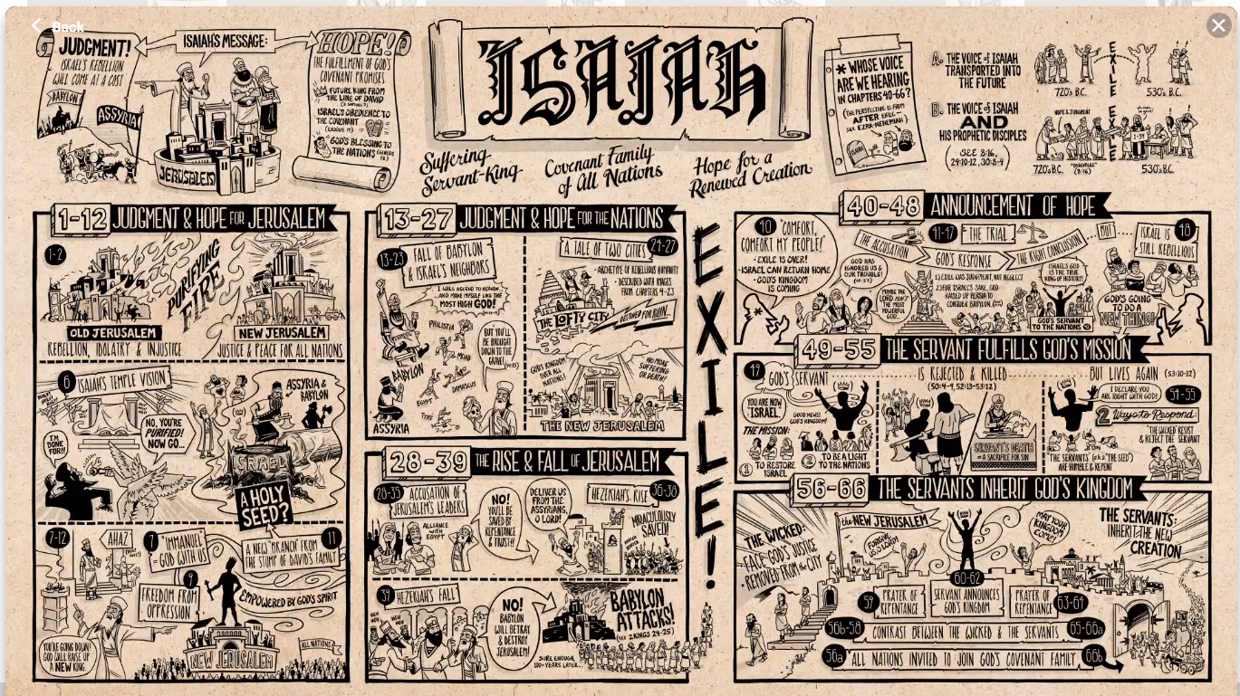
Idea of Deutero-Isaiah is widespread
“Jubiläumsbibel”
Bible Project
Etc.

Slide 5
Arguments against Deutero-Isaiah Hypothesis
First introduced by German Theologians Eichhorn and Dölderlin around 1790
For 2000 + years no one saw a problem
Dead Sea scrolls has one scroll for all chapters. Chapter 40 does not even start a new column.
Unifying themes and unifying structure throughout all chapters
The NT writers refer to Isaiah as author even of the later chapters
Good resource: gotquestions.org
Notes:
I came across the Oxford research Encyclopedias, and this author first claimed that there were different authors. That chapter 1-39 were addressed at the people of Judah in the 8th and 7th century BC, chapters 40-55 were directed at the Jew in the exile in Babylon, and chapters 56-66 speak to the disillusioned people who returned. He says: The book grew and developed over a period of four to five centuries. Despite its sometimes conflicting perspectives, it is broadly unified by its focus on the fate of Jerusalem, and later editors worked to impose some coherence upon its varied content, as seen by the repeated thematic echoes in Isaiah 1 and 65–66.

Slide 6
Message of Isaiah
Restoration of the all nations
Hope for a Restored creation

Slide 7
Mat 4:12-17 (NLT)
¹² When Jesus heard that John had been arrested, he left Judea and returned to Galilee. ¹³ He went first to Nazareth, then left there and moved to Capernaum, beside the Sea of Galilee, in the region of Zebulun and Naphtali. ¹⁴ This fulfilled what God said through the prophet Isaiah:
¹⁵ “In the land of Zebulun and of Naphtali,
beside the sea, beyond the Jordan River,
in Galilee where so many Gentiles live,
¹⁶ the people who sat in darkness
have seen a great light.
And for those who lived in the land where death casts its shadow,
a light has shined.”
﻿¹⁷ From then on Jesus began to preach, “Repent of your sins and turn to God, for the Kingdom of Heaven is near.”
Notes:
This one in Matthew is right after the temptation. It only mentions Jesus doing a brief time of ministry in Nazareth. Matthew does not go into detail what happened in Nazareth, we will see that in the next passage from Luke.
Matthew mentions that Jesus went to the North country – and he (the tax collector!) has enough spiritual understanding that this is a spiritually dark place. He quotes Isaiah the same passage that I quoted in my advent sermon, when I said that this passage was quite literally fulfilled in the night at Christmas. The wider context places is in northern Galilee. Remember Nathanael when Andrew called him to come to Jesus – he said what good can come from Nazareth, the area must have had a bad reputation. It is heathen country! And yet God let his light shine right into that darkness.

Slide 8
Luk 4:14 – 30 (NLT)
¹⁴ Then Jesus returned to Galilee, filled with the Holy Spirit's power. Reports about him spread quickly through the whole region^{. 15} He taught regularly in their synagogues and was praised by everyone.
¹⁶ When he came to the village of Nazareth, his boyhood home, he went as usual to the synagogue on the Sabbath and stood up to read the Scriptures. ¹⁷ The scroll of Isaiah the prophet was handed to him. He unrolled the scroll and found the place where this was written:
¹⁸ “The Spirit of the LORD is upon me,
for he has anointed me to bring Good News to the poor.
He has sent me to proclaim that captives will be released,
that the blind will see,
that the oppressed will be set free,
¹⁹ and that the time of the LORD's favor has come.”
²⁰ He rolled up the scroll, handed it back to the attendant, and sat down. All eyes in the synagogue looked at him intently^{. 21} Then he began to speak to them. “The Scripture you've just heard has been fulfilled this very day!”
Notes:
This passage from Luke also follows the temptation, but it gives a little more detail on what happened in Nazareth.

Slide 9
Luk 4:14 – 30 (NLT)
²² Everyone spoke well of him and was amazed by the gracious words that came from his lips. “How can this be?” they asked. “Isn't this Joseph's son?”
²³ Then he said, “You will undoubtedly quote me this proverb: ‘Physician, heal yourself’—meaning, ‘Do miracles here in your hometown like those you did in Capernaum.’ ²⁴ But I tell you the truth, no prophet is accepted in his own hometown.
²⁵ “Certainly there were many needy widows in Israel in Elijah's time, when the heavens were closed for three and a half years, and a severe famine devastated the land. ²⁶ Yet Elijah was not sent to any of them. He was sent instead to a foreigner—a widow of Zarephath in the land of Sidon. ²⁷ And there were many lepers in Israel in the time of the prophet Elisha, but the only one healed was Naaman, a Syrian.”
²⁸ When they heard this, the people in the synagogue were furious. ²⁹ Jumping up, they mobbed him and forced him to the edge of the hill on which the town was built. They intended to push him over the cliff, ³⁰ but he passed right through the crowd and went on his way.

Slide 10
Jesus in Nazareth
He worked in the expected patterns. As a guest he was expected to speak
He was given the Isaiah scroll
He finds the place and reads
Luke portrays the tension in the room

Slide 11
What Jesus read and what he didn’t read
Isaiah 61: 1,2
¹ The Spirit of the Sovereign Lord is upon me, because the Lord has appointed me to bring good news to the poor. He has sent me to comfort the brokenhearted and to announce that captives will be released and prisoners will be freed. ² He has sent me to tell those who mourn that the time of the Lord's favor has come, and with it, the day of God's anger against their enemies.

Slide 12
What Jesus read and what he didn’t read
Isaiah 61: 1,2
¹ The Spirit of the Sovereign Lord is upon me, because the Lord has appointed me to bring good news to the poor. He has sent me to comfort the brokenhearted and to announce that captives will be released and prisoners will be freed. ² He has sent me to tell those who mourn that the time of the Lord's favor has come, and with it, the day of God's anger against their enemies.
Notes:
Indirectly, Jesus is saying I am here now to fulfill this first part of the Messianic ministry. I am bringing salvation now, Judgment will come later.

Slide 13
Jesus’ Message
“The Scripture you've just heard has been fulfilled this very day!”
Jesus unmistakably claims to be the Messiah
First reaction: Isn’t this Joseph’s son?
Passive Unbelief
Jesus responds with a proverb: A prophet is not accepted in his home town.

Slide 14
Jesus explains messianic ministry
Elijah was sent to the widow of Zarephath – a gentile!
Elisha healed Naaman of his leprosy – a gentile!
Even though Jesus does not say it directly the message is clear: The Messiah a Messiah for the Gentiles
So clear it stirs up anger among the audience (active unbelieve)

Slide 15
Messianic expectations
What the Jews expected
What actually happened
Messiah would be from Bethlehem, Judah
He would bring relief from suffering and judge the oppressors (especially the Romans)
He would be there for the Jews and restore David’s throne and the kingdom of Israel
His hometown was Nazareth
He was here now just to bring relief and salvation
He came for the salvation of the all nations! His throne is over a universal kingdom

Slide 16
A Messiah for the nations
This idea was a novelty for many Jews
Paul calls it a mystery hidden for ages past
However, it was there for people to see (if they wanted to)
When Abraham was called it was to bless all nations through him
Many prophets – especially Isaiah – make it clear that God’s goal is restoration of the whole earth, not just Israel
The reaction of the Jews in Nazareth is repeated when Paul gets arrested in Jerusalem (Acts 22)
Notes:
In several places: Eph 3: This mystery is that through the gospel the Gentiles are heirs together with Israel, members together of one body, and sharers together in the promise in Christ Jesus.

Slide 17
Who do you believe Jesus is?
A good man?
A great teacher?
The Messiah who brings salvation to you and every one else near and far

